Slide 1
CSCI 1070:
Taming Big Data
Dr. Abby Stylianou

Slide 2
Logistics
Due to Blackboard issues, we will be using Moodle instead
Assignment 0 is out today. We will hopefully work on it in class and discuss how to turn it in. It’s due next Tuesday before class.
Late assignment policy:
Assignments are due at 10:59am on their due date.
From 11:00am that day to 10:59am the following day, 10% off
The next day, another 10% off
So on and so forth

Slide 3
Graphical User Interfaces vs. Command Line Interfaces

Slide 4
Writing and Running Code
Old-school pipeline:
Write a text file with python code in it
Save it to program_name.py
Go to your command line interface and run:
python program_name.py

Slide 5
Writing and Running Code
Old-school pipeline:
Write a text file with python code in it
Save it to program_name.py
Go to your command line interface and run:
python program_name.py
Let’s do that!

Slide 6
Let’s Create a Folder for Our Class
Name the folder cs1070
I don’t care where you put it, but I’d make it somewhere easy to get to (such as in your Documents folder)
Get the “full path” for the folder
I’ll walk around and help with this if you can’t figure it out but it should be something like:
/Users/abby/Documentrs/cs1070/ (mac)
/home/abby/Documents/cs1070/ (linux)
C:\Users\abby\Documents (windows)

Slide 7
Write our first program:
Open a text editor
Type the following code: print(’Hello world’)
Save the file as first_program.py in that folder you just created

Slide 8
Open the Command Line Interface
On Mac or Linux machines, open the application called “Terminal”
On Windows machines, open the application called “Command Prompt”

Slide 9
Navigate to the Right Folder
Remember the “full path” for the folder you created?
/Users/abby/Documentrs/cs1070/ (mac)
/home/abby/Documents/cs1070/ (linux)
C:\Users\abby\Documents (windows)
In the command line, type in:
cd /path/to/your/folder
replacing /path/to/your/folder with …. the path to your folder
(this command should work for Linux, Mac and Windows)

Slide 10
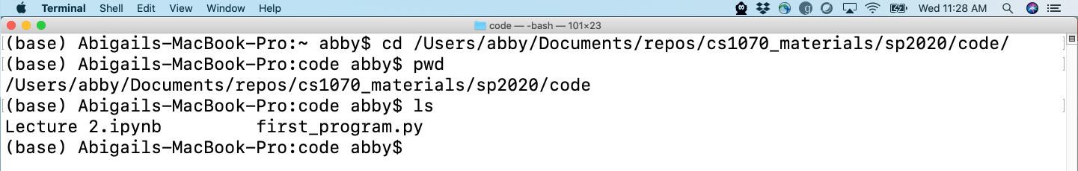
A Couple Useful Commands
cd : stands for “change directory”
list the contents of the current directory
Linux/Mac: ls
Windows: dir
get the full path of the present working directory
Linux/Mac: pwd
Windows: cd (without any directory passed in)

Slide 11
Running Your Program
Now that we’ve opened the command line and navigated to the correct folder, we’re ready to run our program.
In the command line interface, type:
python first_program.py

Slide 12
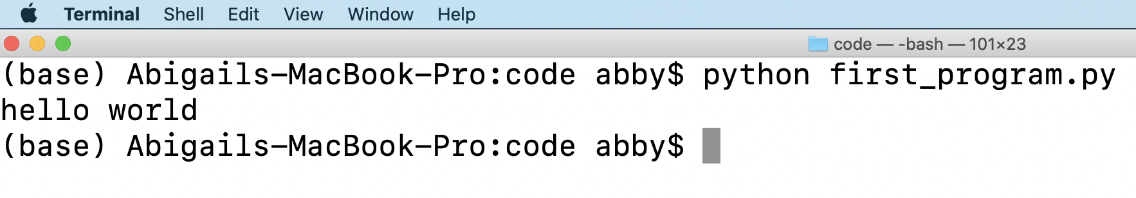

Slide 13
Jupyter Notebooks
Write and run Python code in the browser

Slide 14
Jupyter Notebooks
Installed on the lab machines already.
Open Terminal/Command Prompt and run:
pip install jupyter
(if that fails, you might need to run pip install --user jupyter)
The lab machines already have it installed
If your computer doesn’t have pip (Windows machines especially may not, use a lab machine today and come to office hours to get set up)

Slide 15
Jupyter Notebooks
To start a new notebook, first navigate to the folder you create earlier in Terminal (what was the command?)
Then, run:
jupyter notebook

Slide 16
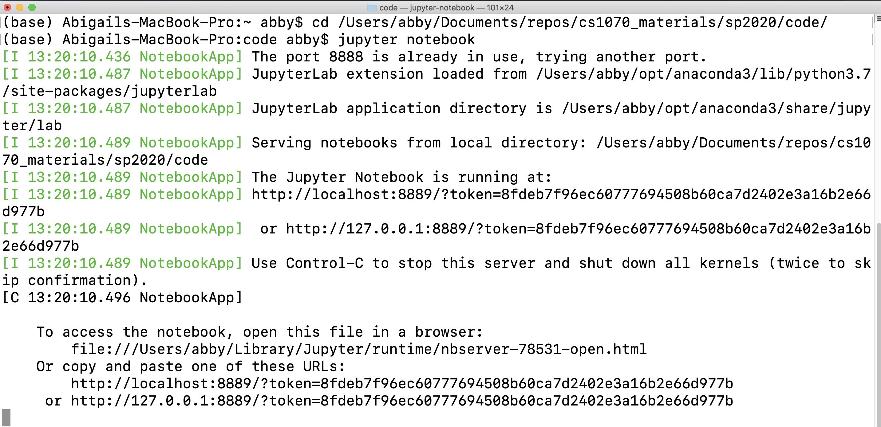

Slide 17
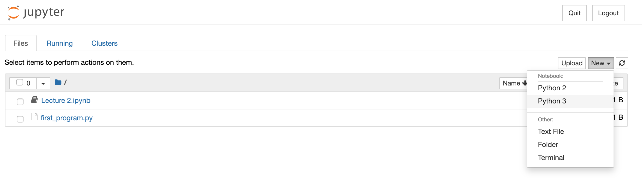

Slide 18
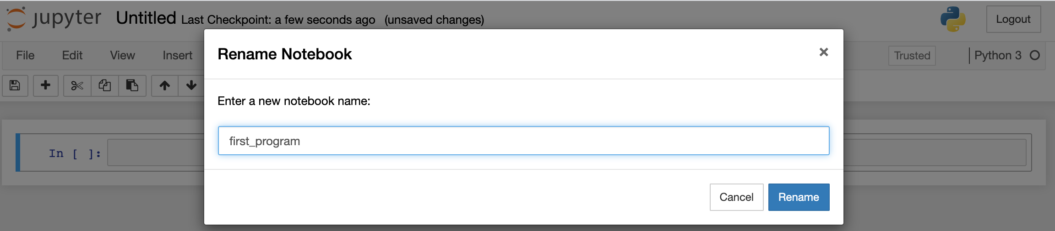

Slide 19
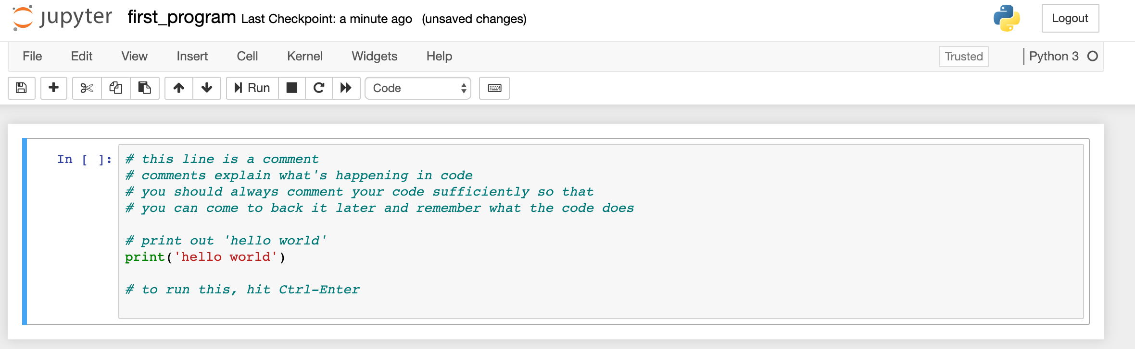

Slide 20
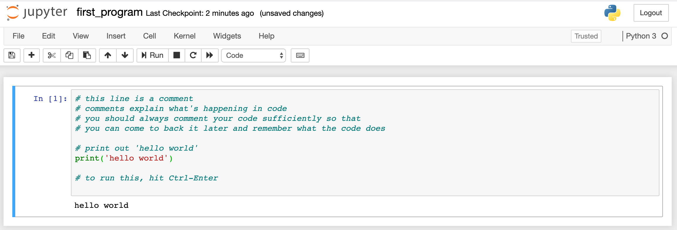

Slide 21
Assignment 0

